Slide 1
Transfer Function
Linear Circuit Analysis II
EECE 202 – Spring 2025

Slide 2
Announcement
Midterm during week 8
PD 1 Voice Over PPT due in Week 10

Slide 3
Recap
Impedances
Admittances
New Material
Transfer functions
Initial and final value theorem

Slide 4
Transfer Function
Zero initial conditions
No stored Energy
Input
Output
$$H\left(s\right)= \frac{L[output signal]}{L[input signal]}$$

Slide 5
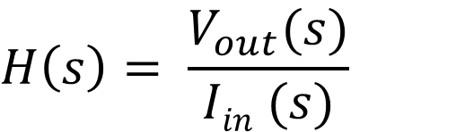
Example -1
Calculate H(s) for the shown circuit
$$H\left(s\right)= \frac{V_{out}(s)}{Iin (s)}$$
Using source transformation and voltage division

Slide 6
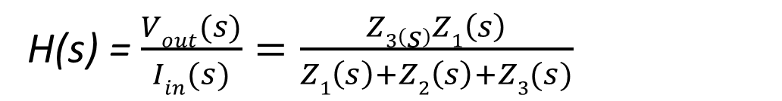
Example -1
salman
Calculate H(s) for the shown circuit
$$H\left(s\right)= \frac{V_{out}(s)}{Iin (s)}$$
Using source transformation and voltage division
V_{out}(s)=$\frac{Z3(s)}{Z1\left(s\right)+Z2\left(s\right)+Z3(s)}$ $\overline{V} \left(s\right)=\frac{Z3\left(s\right)Z1\left(s\right)Iin(s)}{Z1\left(s\right)+Z2\left(s\right)+Z3(s)}$
H(s) = $\frac{Vout(s)}{Iin(s)}=\frac{Z3\left(s\right)Z1\left(s\right)}{Z1\left(s\right)+Z2\left(s\right)+Z3(s)}$

Slide 7
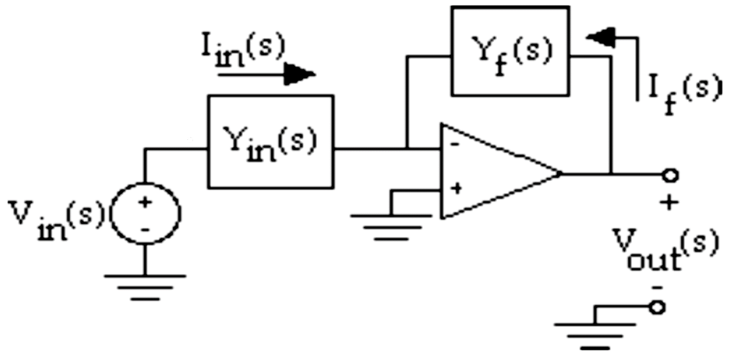
Example -2 Transfer function for
Op Amp Circuits
For the circuit shown, show that
By applying KCL at the inverting input node noting that this is the virtual ground node
Note: You can use nodal analysis at the virtual ground node. You must get the same result.

Slide 8
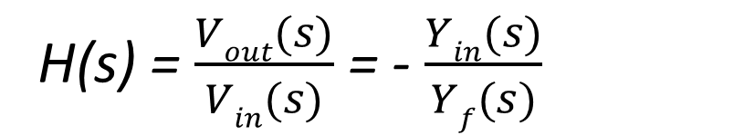
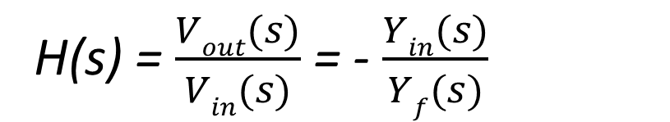
salman
Example -2 Transfer function for
Op Amp Circuits
For the circuit shown, show that
H(s) = $\frac{Vout(s)}{Vin(s)}$ = - $\frac{Yin(s)}{Yf(s)}$
By applying KCL at the inverting input node noting that this is the virtual ground node
I_{in}(s) = - I_{f}(s)
Y_{in}(s) V_{in}(s) = -Y_{f}(s) V_{out}(s)
H(s) = $\frac{Vout(s)}{Vin(s)}$ = - $\frac{Yin(s)}{Yf(s)}$
Note: You can use nodal analysis at the virtual ground node. You must get the same result.

Slide 9
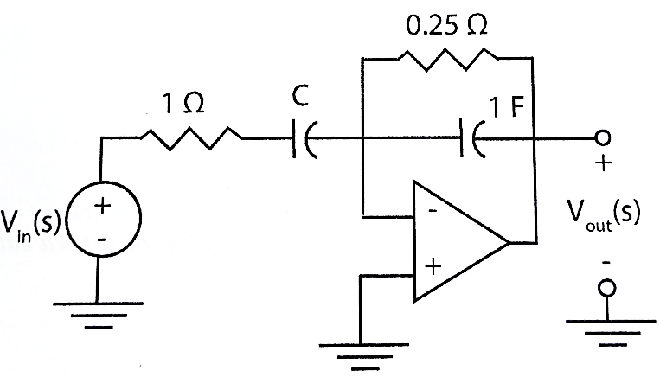

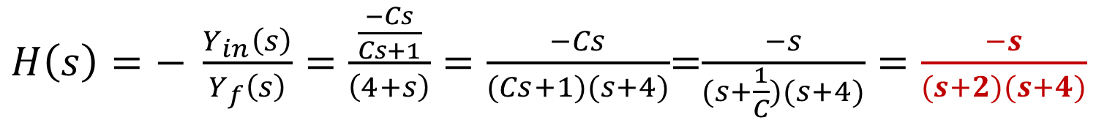

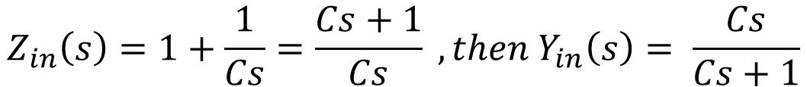
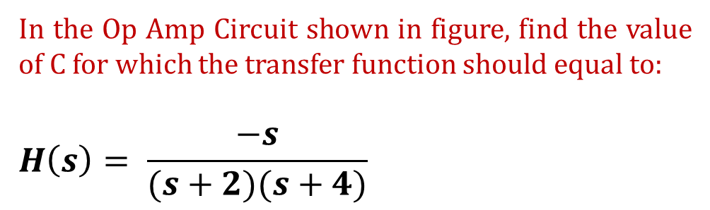
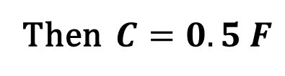
Example -2
In the Op Amp Circuit shown in figure, find the value of C for which the transfer function should equal to:
$$H\left(s\right)= \frac{−s}{(s+2)(s+4)}$$
By comparing the circuit of example 2 with the general inverting amplifier circuit shown below
$$Z_{in}\left(s\right)=1+\frac{1}{Cs}=\frac{Cs+1}{Cs} , then Y_{in}\left(s\right)= \frac{Cs}{Cs+1}$$
$$Y_{f}\left(s\right)=4+s$$
$H\left(s\right)=− \frac{Y_{in}\left(s\right)}{Y_{f}\left(s\right)}=\frac{\frac{−Cs}{Cs+1}}{\left(4+s\right)}=\frac{−Cs}{(Cs+1)(s+4)}$=$\frac{−s}{(s+\frac{1}{C})(s+4)}=\frac{−s}{(s+2)(s+4)}$
Then $C=0.5 F$
Notes:
This is example 3.27 from the book, page 629

Slide 10
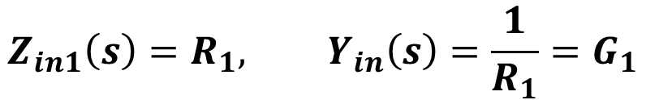
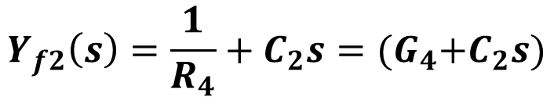
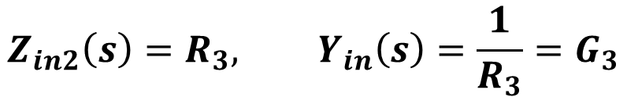
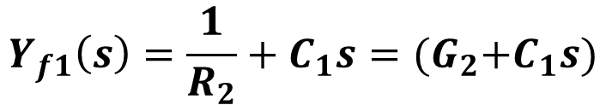
Example -3
In the Op Amp Circuit shown in figure, find the values of R1, R2, R3, R4, C1 and C2 so that the transfer function should equal to:
$$V_{in}(t)$$
Also, find the impulse and step response.
Solution
As what have been done in the previous example, we can find H1(s) and H2(s)
$$Z_{in1}\left(s\right)=R_{1}, Y_{in}\left(s\right)=\frac{1}{R_{1}}=G_{1}$$
$$Y_{f1}\left(s\right)=\frac{1}{R_{2}}+C_{1}s={(G}_{2}+C_{1}s)$$
$$Z_{in2}\left(s\right)=R_{3}, Y_{in}\left(s\right)=\frac{1}{R_{3}}=G_{3}$$
$$Y_{f2}\left(s\right)=\frac{1}{R_{4}}+C_{2}s={(G}_{4}+C_{2}s)$$
Notes:
This is similar to an exercise from the book, page 663, example 26

Slide 11
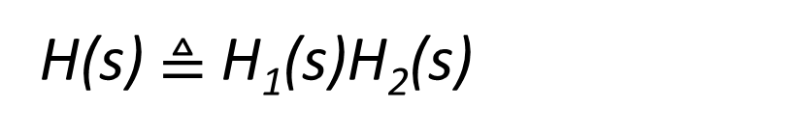
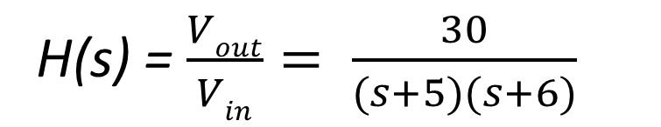
salman
Example -3
In the Op Amp Circuit shown in figure, find the values of R1, R2, R3, R4, C1 and C2 so that the transfer function should equal to:
$$V_{in}(t)$$
H(s) = $\frac{Vout}{Vin}= \frac{30}{(s+5)(s+6)}$
Also, find the impulse and step response.
Solution
H(s) $≜$H₁(s)H₂(s)
As what have been done in the previous example, we can find H1(s) and H2(s)
$$Z_{in1}\left(s\right)=R_{1}, Y_{in}\left(s\right)=\frac{1}{R_{1}}=G_{1}$$
$$Y_{f1}\left(s\right)=\frac{1}{R_{2}}+C_{1}s={(G}_{2}+C_{1}s)$$
$$Z_{in2}\left(s\right)=R_{3}, Y_{in}\left(s\right)=\frac{1}{R_{3}}=G_{3}$$
$$Y_{f2}\left(s\right)=\frac{1}{R_{4}}+C_{2}s={(G}_{4}+C_{2}s)$$
Notes:
This is similar to an exercise from the book, page 663, example 26

Slide 12
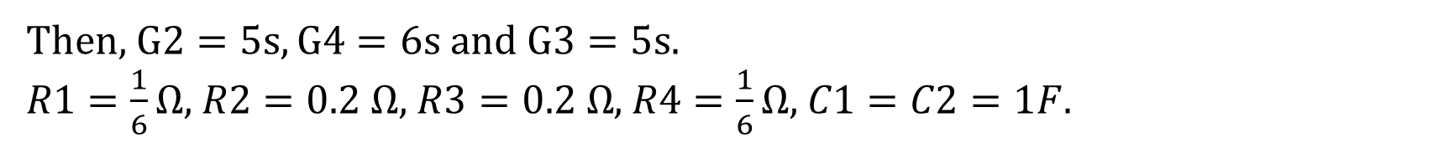
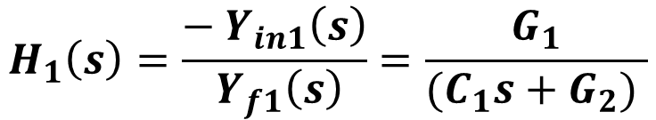
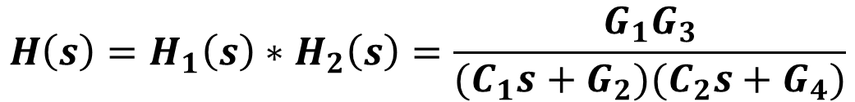
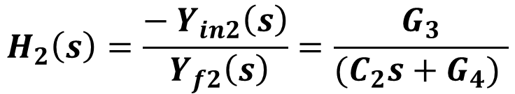
Example -3 (Contin…)
$$H_{1}\left(s\right)=\frac{−{ Y}_{in1}\left(s\right)}{{ Y}_{f1}\left(s\right)}=\frac{G_{1}}{{(C_{1}s+G}_{2}) }$$
$$H_{2}\left(s\right)=\frac{−{ Y}_{in2}\left(s\right)}{{ Y}_{f2}\left(s\right)}=\frac{G_{3}}{{(C_{2}s+G}_{4}) }$$
$$H\left(s\right)=H_{1}\left(s\right)∗H_{2}\left(s\right)=\frac{G_{1}G_{3}}{{(C_{1}s+G}_{2}){(C_{2}s+G}_{4})}$$
Since we have 6 unknowns and 3 equations, we can assume the values of 3 variables
Assume $C1=C2=1F$ and $G1=6s$
Then, $G2=5s, G4=6s$and $G3=5s.$
$R1=\frac{1}{6}Ω$, $R2=0.2$ $Ω$, $R3=0.2 Ω$, $R4=\frac{1}{6}Ω$, $C1=C2=1F$.

Slide 13
Impulse Response

Slide 14
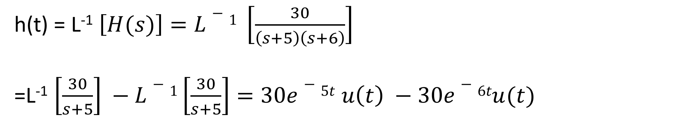
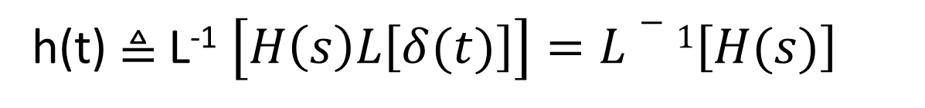
salman
Impulse Response
h(t) $≜$L⁻¹ $\left[H\left(s\right)L\left[δ(t)\right]\right]=L−1\left[H(s)\right]$
h(t) = L⁻¹ $\left[H(s)\right]=L−1 \left[\frac{30}{\left(s+5\right)\left(s+6\right)}\right]$
=L⁻¹ $\left[\frac{30}{s+5}\right] −L−1\left[\frac{30}{s+5}\right]=30e−5t u\left(t\right) −30e−6tu(t)$

Slide 15
Step Response

Slide 16
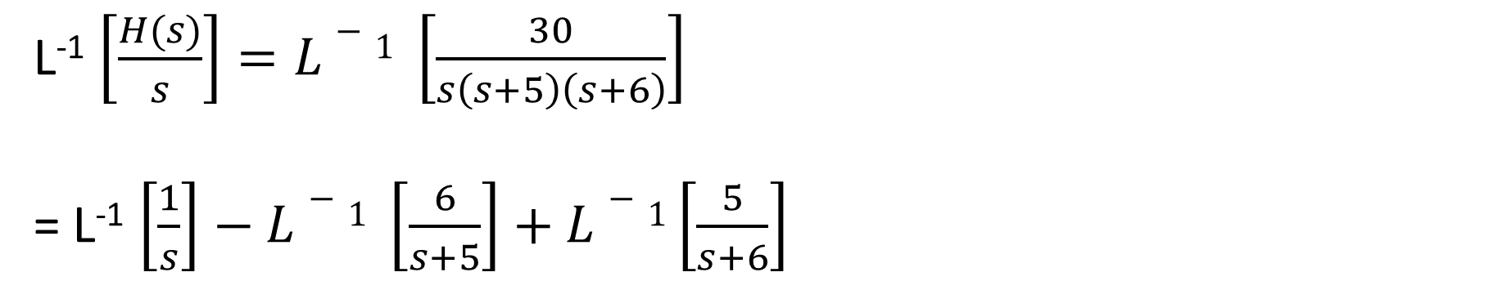
salman
Step Response
Step Response $≜$ L⁻¹ $\left[H\left(s\right)L\left[u(t)\right]\right]=L−1\left[\frac{H(s)}{s}\right]$
L⁻¹ $\left[\frac{H(s)}{s}\right]=L−1 \left[\frac{30}{s\left(s+5\right)\left(s+6\right)}\right]$
= L⁻¹ $\left[\frac{1}{s}\right]−L−1 \left[\frac{6}{s+5}\right]+L−1\left[\frac{5}{s+6}\right]$
Step Response = $\left[1 −6e−5t+5e−6t\right] u(t)$

Slide 17
Initial and Final Values

Slide 18
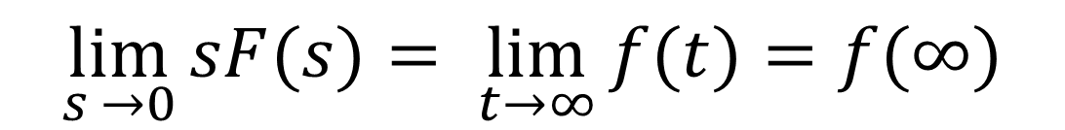
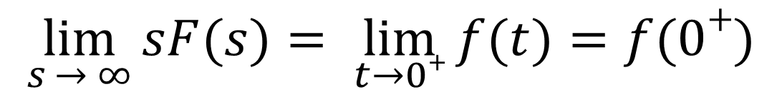
salman
Initial and Final Values
Initial Value Theorem.
$$\lim_{s → ∞}{sF(s)}= \lim_{t→0+}{f(t)}=f(0+)$$
Initial Value Theorem.
$$\lim_{s →0}{sF(s)}= \lim_{t→∞}{f(t)}=f(∞)$$

Slide 19
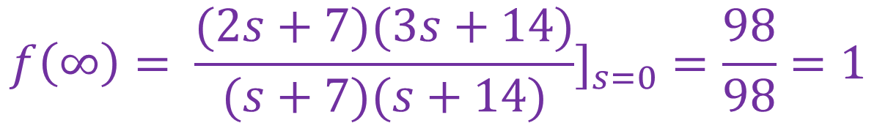
Example -4
Find f(0+) and f(∞) for the following function
Solution
$$f\left(∞\right)= \frac{(2s+7)(3s+14)}{(s+7)(s+14)}]_{s=0}=\frac{98}{98}=1$$

Slide 20
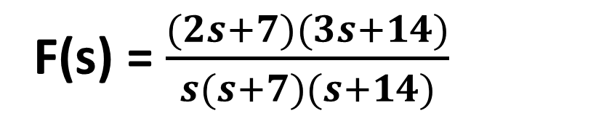
salman
Example -4
Find f(0+) and f(∞) for the following function
F(s) = $\frac{(2s+7)(3s+14)}{s(s+7)(s+14)}$
Solution
$$f\left(0+\right)= \lim_{s→∞}{sF\left(s\right)=\lim_{s→∞}{\frac{(2s+7)(3s+14)}{(s+7)(s+14)}=6}}$$
$$f\left(∞\right)= \frac{(2s+7)(3s+14)}{(s+7)(s+14)}]_{s=0}=\frac{98}{98}=1$$

Slide 21
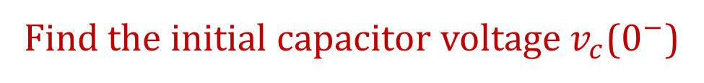
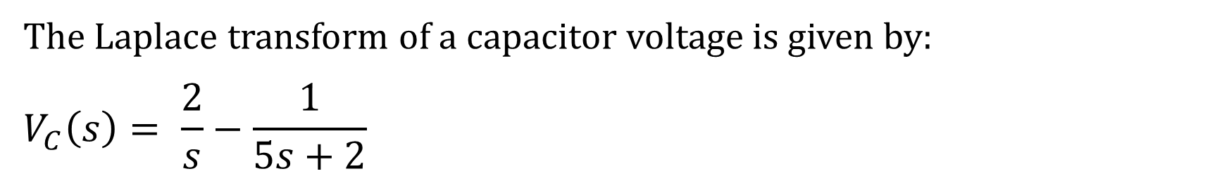
Example -5
The Laplace transform of a capacitor voltage is given by:
$$V_{C}\left(s\right)= \frac{2}{s}−\frac{1}{5s+2}$$
Find the initial capacitor voltage $v_{c}$($0^{−}$)
Solution
By applying the initial value theorem
$$V_{C}{(0}^{+}) =\lim_{s…∞}{sV_{C}\left(s\right)=\lim_{s…∞}\left[\frac{2s}{s}−\frac{s}{5s+2}\right]=2−0.2=1.8 V}$$

Slide 22
Answer the following questions using ChatGPT
What is the primary purpose of a transfer function in analyzing linear circuits?
Why are initial conditions often assumed to be zero when calculating a transfer function?
What is the significance of finding the impulse response of a circuit from its transfer function?
How does the step response of a system differ from its impulse response, and what does it indicate about the system's stability?

Slide 23
Summary
Transfer function
Impulse response
Step response
Initial and final value
Page 626, example 13.9
Page 629, example 13.11
Page 636, example 13.16
Page 640, exercise
Page 662, example 21
Page 663, example 26
Page 664, example 29
Page 665, example 31

